Slide 1
Algorithm Implementation in Game I Session 13
Course : COMP6228 – Artificial Intelligence
Effective Period : February 2018

Slide 2
Learning Objective
After completing this session, students are expected to be able to:
LO 1 : Describe how Artificial Intelligence works in Games
LO 2 : Explain concepts of AI Techniques in Games

Slide 3
Contents
Decision Tree
Decision Tree: Implementation

Slide 4
Algorithms For Behaviours

Slide 5
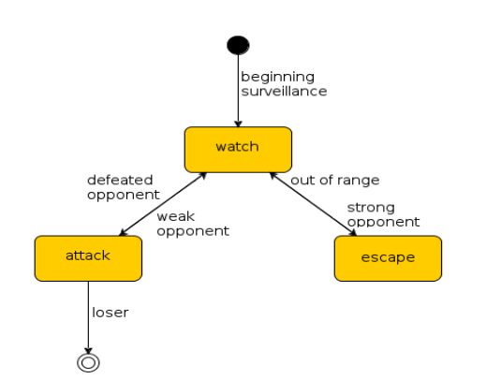
Decision Tree

Slide 6
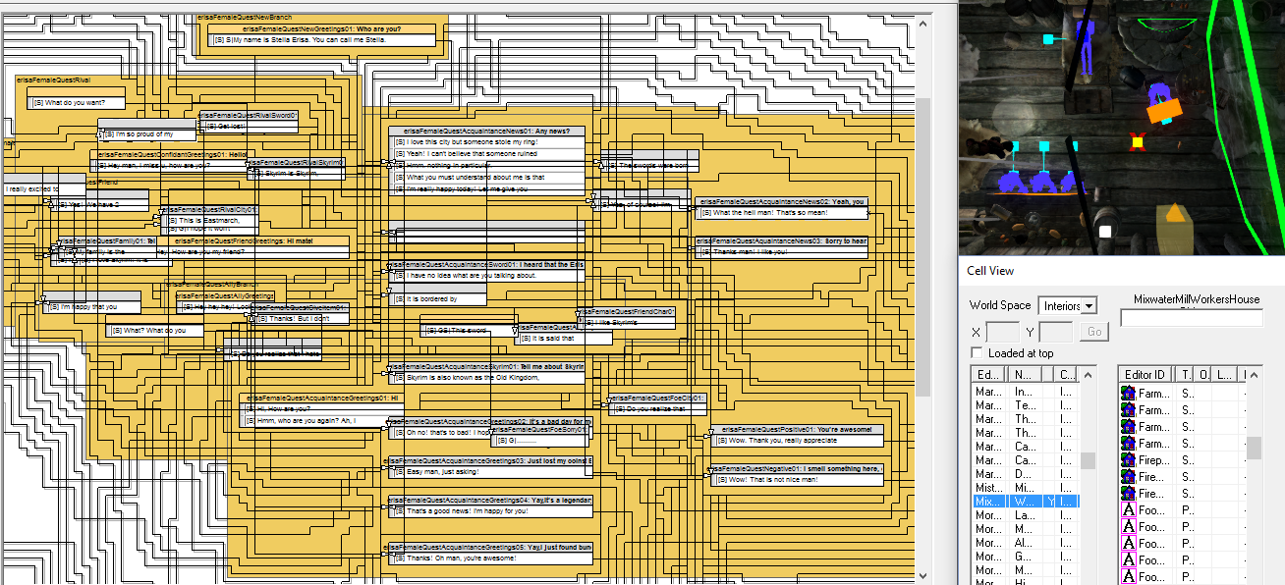
Decision Tree Implementation

Slide 7
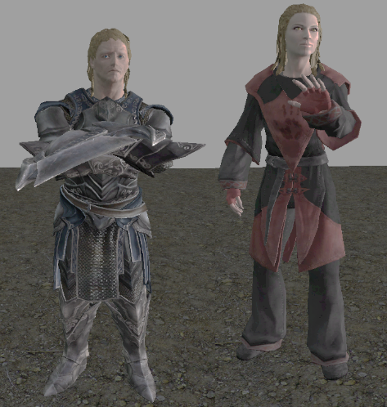
Decision Tree Implementation
Create two characters to be implemented in a RPG game (in this case, we choose Skyrim as they open a kit for developer)
The Characters named Max (Male, Left) and Stella (Female, Right)
[1] Chowanda, A., Flintham, M., Blanchfield, P., & Valstar, M. (2016, September). Playing with social and emotional game companions. In International Conference on Intelligent Virtual Agents (pp. 85-95). Springer International Publishing.

Slide 8
Decision Tree Implementation
In addition to the mechanics, stories, aesthetics and technologies provided by Skryim, a researcher [1] designed two characters and a quest to the game.
The ERiSA computational models modify the mechanics for building relationship between player and game companion in the game. However, the researcher used Skyrim's original mechanics for building relationships as a baseline to compare with.
The researcher argue that with our proposed computational models implemented to the Skyrim game will increase the player experience (e.g. emotions when playing games), immersion and engagement to the character, game and story.
[1] Chowanda, A., Flintham, M., Blanchfield, P., & Valstar, M. (2016, September). Playing with social and emotional game companions. In International Conference on Intelligent Virtual Agents (pp. 85-95). Springer International Publishing.

Slide 9
Decision Tree Implementation
The researcher designed two game companions with opposite personality to interact with.
[1] Chowanda, A., Flintham, M., Blanchfield, P., & Valstar, M. (2016, September). Playing with social and emotional game companions. In International Conference on Intelligent Virtual Agents (pp. 85-95). Springer International Publishing.

Slide 10
Decision Tree Implementation
The dialogue system in Skyrim implements a dialogue tree model provided by Skyrim Creation Kit.
Ten topics were designed to the game dialogues. the availability of particular topics depends on the social relationships between them, as well as the player's and game companion's emotions.
To make it easy to maintain, the researcher designed the dialogue with card based method.
Each card contains information about the topic category, utterances, conditions and the effects.
[1] Chowanda, A., Flintham, M., Blanchfield, P., & Valstar, M. (2016, September). Playing with social and emotional game companions. In International Conference on Intelligent Virtual Agents (pp. 85-95). Springer International Publishing.

Slide 11
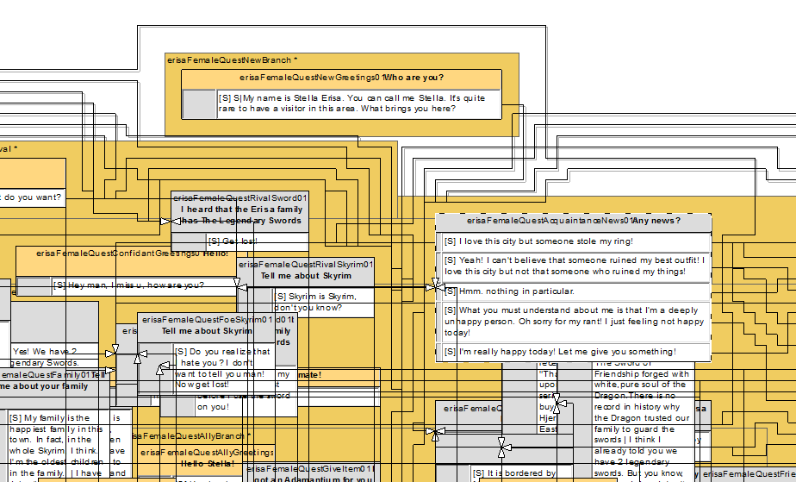
Decision Tree Implementation
[1] Chowanda, A., Flintham, M., Blanchfield, P., & Valstar, M. (2016, September). Playing with social and emotional game companions. In International Conference on Intelligent Virtual Agents (pp. 85-95). Springer International Publishing.

Slide 12
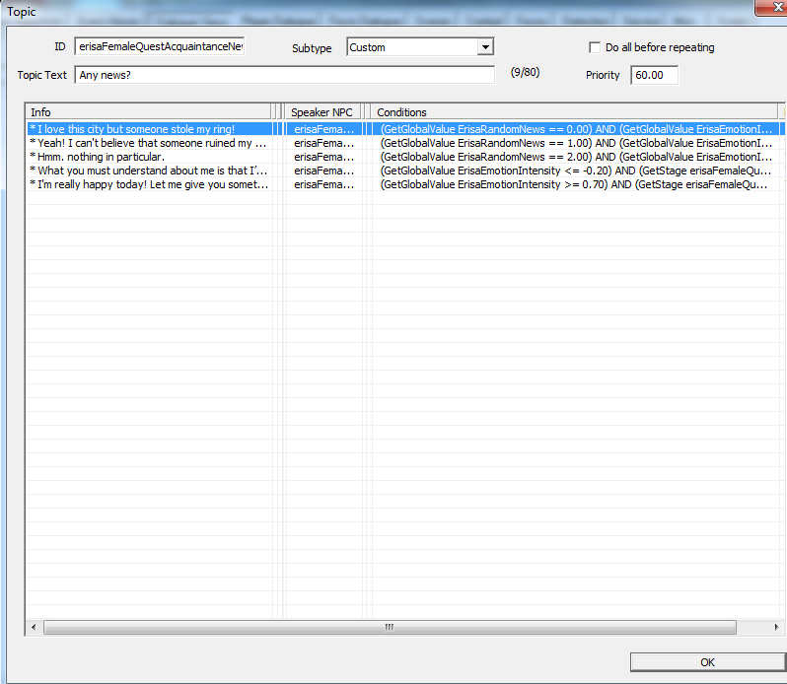
Decision Tree Implementation

Slide 13
Decision Tree Implementation
[1] Chowanda, A., Flintham, M., Blanchfield, P., & Valstar, M. (2016, September). Playing with social and emotional game companions. In International Conference on Intelligent Virtual Agents (pp. 85-95). Springer International Publishing.

Slide 14
Decision Tree Implementation
The conditions indicate the requirement criteria for the dialogue card to appear as a dialogue option for the player.
The utterances show the reply that the player will get if they choose the utterance.
Finally, each card has its own effect after it has been chosen. For example: a Sword01 card has a pre-condition that the level of their social relationship is acquaintance (either positive or negative) of the NPC towards player at time t must be in the low category. If those conditions are met, the option of player saying ``I heard that the Erisa Family has the Legendary Swords'' is available.
It will give an increase to the NPC's Familiarity, if that utterance is chosen by the player.

Slide 15
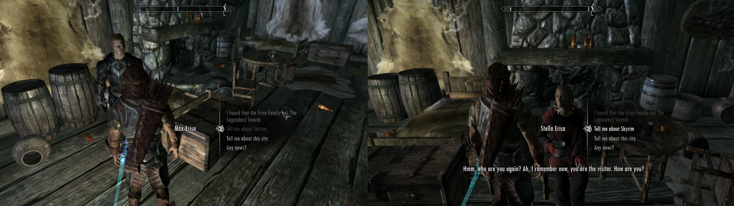
Decision Tree Implementation
All those dialogue and behaviour are scripted in a behaviour tree using the dialogue manager provided by the Skyrim Creation Toolkit.
The first branch is the NPC’s personality

Slide 16
References
Ian Millington. 2009. Artificial intelligence for games. Morgan Kaufmann Publishers. Burlington. ISBN:9780123747310
Playing with Social and Emotional Game Companions, http://www.cs.nott.ac.uk/~pszmv/Documents/IVA_2016_ShortPaper.pdf
Computational Models of Emotion, Personality, and Social Relationships for Interactions in Games, http://trust.sce.ntu.edu.sg/aamas16/pdfs/p1343.pdf
Using Artificial Neural Networks in NPC DecisionMaking Process, https://www.ijcit.com/archives/volume2/issue6/Paper020601.pdf
ERiSA: Building Emotionally Realistic Social Game-Agents Companions, https://pdfs.semanticscholar.org/7917/4bc58d956a8061e191fb76f310ef4588b8fa.pdf

